Slide 1
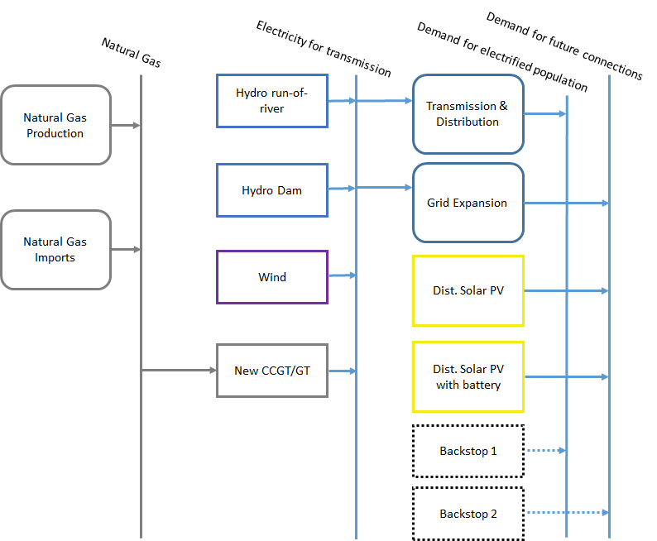
Defining the transmission & distribution grid
Resources
Primary
Secondary
Final

Slide 2
Defining the transmission & distribution grid
Resources
Primary
Secondary
Final

Slide 3
Defining the Transmission & Distribution grid in OSeMOSYS
In OSeMOSYS, thermal power plants are characterized by the following parameters:
InputActivityRatio: defines the rate of fuel consumed (i.e. Electricity)
OutputActivityRatio: defines the rate of fuel provided (i.e. Electricity)
CapitalCost [M$/GW or $/kW]: defines the overnight investment cost of the network grid
FixedCost [M$/GW or $/kW]: defines the fixed Operation & Maintenance cost
VariableCost [M$/GWh]: defines the variable costs of the network grid
OperationalLife [yr]: defines the lifetime of the technology

Slide 4
Defining the Transmission & Distribution grid in OSeMOSYS
Electricity
Transmission & Distribution grid
Electricity
In OSeMOSYS, the transmission & distribution grid is mainly characterized by the following parameters:
  OutputActivityRatio: always one output - electricity
  InputActivityRatio: always one input – electricity
e.g. InputActivityRatio – Electricity – 1
OutputActivityRatio – Electricity – 0.95
Meaning that for 1 energy unit of electricity fed to the grid by power plants, 0.95 is delivered to final consumers due to losses

